Slide 1
ENERGY CONSUMPTION AND PREDICTION PROJECT – INFOSYS SPRINGBOARD:
BY MAGULURI KAVYA

Slide 2
Contents:
Project Objective and Overview | The project aims to analyze household energy consumption patterns and forecast future demand using data exploration, visualization, and predictive modeling.
Milestone 1 | Basic Data Exploration
Milestone 2 | Data Visualization and Encoding
Milestone 3 | Model Creation and Comparison
Milestone 4 | Time Series Forecasting With ARIMA And Prophet
Model Evaluation | Model evaluation using metrics to assess accuracy and performance of predictive models
Conclusion | Summarizing Insights and Recommendations For Optimizing Household Energy Consumption.

Slide 3
Dataset:
Household Power Consumption File
(Drive Link): https://drive.google.com/file/d/1Ed2J_M6piMDaPew780mORke29Do5-YQ3/view?usp=sharing

Slide 4
01
Project Objective and Overview:

Slide 5
Project Objective:
The primary objective of this project is to analyze household power consumption data to:
Identify consumption patterns: Understand how energy usage varies over time and across different appliances.
Discover peak usage times: Pinpoint the times when energy demand is at its highest.
Handle data challenges: Address missing values and fluctuations to ensure accurate analysis.
Forecast future demand: Use advanced time-series models to predict household energy requirements.
Derive actionable insights: Provide recommendations for optimizing energy consumption and improving energy efficiency in households.

Slide 6
Project Overview:
The project analyses household energy usage using a dataset with minute-level data on power consumption, voltage, intensity, and appliance usage.
Milestones:
Data Exploration: Examined dataset structure and handled missing data.
Visualization & Encoding: Visualized trends and encoded time-based features.
Model Creation: Developed regression models to analyse consumption.
Forecasting: Predicted future energy usage with ARIMA and Prophet.
Outcome:
Insights into energy patterns and models for forecasting consumption.

Slide 7
Milestone 1:
02
(BASIC DATA EXPLORATION)

Slide 8
Dataset Description:
Key Features:
Global Active Power: Total active power consumption.
Global Reactive Power: Power used for maintaining electric and magnetic fields.
Voltage: Power supply voltage.
Global Intensity: Total current intensity for the household.
Sub-metering 1, 2, 3: Energy consumption by specific appliances (e.g., kitchen, laundry, climate control).
Dataset Size:
Rows: 2,075,261
Columns: 9

Slide 9
Initial Data Inspection:
df.head(): Sample of the first 5 rows.
df.shape: The dataset has over 2 million rows and 9 columns.
df.info(): Revealed that most features are of type 'object', except for 'Sub_metering_3' which is numeric.
The functions df.head(), df.shape, and df.info() are essential for initial data exploration. df.head() displays the first five rows of the dataset, providing a quick glance at its structure and variable types. df.shape returns the dimensions of the dataset, indicating the number of rows and columns, which helps assess its size. df.info() offers a concise summary, including the data types of each column and the count of non-null values, helping identify missing data and potential type conversion needs. Together, these functions help in understanding the dataset’s structure, size, and quality before further analysis or cleaning.

Slide 10
Missing Data Analysis and Handling:
Missing data was identified and addressed using several methods. The dataset contained missing values in certain columns, which were handled by filling the gaps with default values such as zero, the mean, or the median of the respective column. Alternatively, rows containing missing data were removed to ensure that the dataset remained as clean and accurate as possible for analysis. These steps were essential in preparing the data for further exploration and model building.

Slide 11
Data Visualization & Insights:
Visualizations: Histogram and boxplot for power consumption, correlation heatmap to identify relationships (plot(), sns.heatmap()).
Added time-based features by converting 'Date' and 'Time' to datetime and extracting hour, day, and month for deeper analysis (pd.to_datetime()).
In Milestone 1, the dataset was explored, revealing that 'Sub_metering_3' had the most missing values, which were handled using mean, median, or zero. Data types were reviewed, and 'object' columns like 'Global_active_power' need conversion to numeric for analysis. Various strategies were applied to handle missing values, resulting in a cleaner dataset. Visual analysis showed patterns in power consumption linked to specific times or seasons. Recommendations include using time-series models with newly created datetime features for better forecasting and further cleaning outliers and noise for more accurate predictions.

Slide 12
Analysis:
Functions | Use case | Observations
df.head() | Displays the first 5 rows of the dataset to preview its structure and values. | We can see the first 5 rows of our dataset
df.tail() | Displays the last 5 rows of the dataset to inspect the end of the data. | We can see the last 5 rows of our dataset
df.shape | Returns the number of rows and columns in the dataset. | The number of rows and columns are displayed(2075259, 9)
df.info() | Provides a summary of the dataset, including data types and non-null counts. | We can see that only sub_metering3 is of float type all others are object type.
df.describe() | Generates summary statistics (mean, std, min, max, etc.) for numeric columns. | The respective values are displayed
df.isnull().sum() | Identifies the number of missing values in each column. | Sub_metering3 has 25979 null values
df.fillna(0) | Fill the null value with 0’s. | After filling it shows some rows of our data.
df.fillna(df['Sub_metering_3'].mean()) | Fills the null values with the mean of the column. | After filling with the mean it outputs some sample of data.
df.fillna(df['Sub_metering_3'].median()) | Fills the null values with the median of the column. | After filling with the median it outputs some sample of data.
df.unique() | Lists the unique values in a column. | It displays number of unique values in each column

Slide 13
Milestone 2:
03
(DATA VISUALISATION AND ENCODING)

Slide 14
Process:
Objective: Analyze and preprocess the dataset for power consumption forecasting.
Key Steps:
Loaded household_power_consumption.txt (133MB).
2,075,259 rows, 9 columns.
Missing values and non-numeric data identified.
Handled missing values:
Converted non-numeric to NaN.
Filled missing values with 0.
Outcome: Cleaned dataset, ready for analysis and feature engineering.

Slide 15
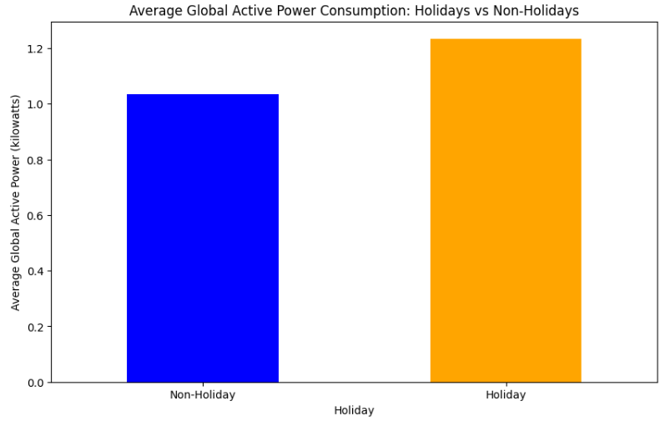
Feature Engineering - Holiday:
Objective: Identify if the day is a holiday or not.
Method:
Created a function is_holiday(date_str) to check if the day falls on a weekend.
Added a 'Holiday' column (binary: 1 for holiday, 0 for non-holiday).
Observations: All data points in the dataset are marked as holidays (value 1). Need additional non-holiday data for comparison.

Slide 16
Feature Engineering - DateTime:
Objective: Convert Date and Time columns into a single DateTime column.
Method:
Combined 'Date' and 'Time' into 'DateTime' using pd.to_datetime().
Outcome: The 'DateTime' column is now in the standard format (YYYY-MM-DD HH:MM:SS) for time-based analysis.

Slide 17
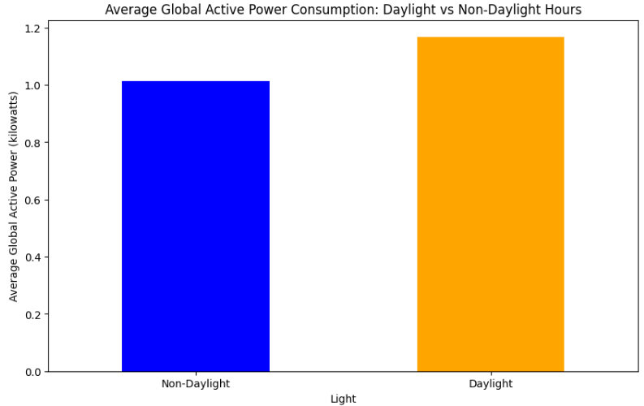
Feature Engineering - Sunlight:
Objective: Identify whether it is daylight or not (from 06:00 AM to 06:00 PM).
Method:
Created a function is_light(hour) to check if the hour falls within daylight hours (6 AM to 6 PM).
Added a 'light' column to represent daylight status (1 for daylight, 0 for non-daylight).
Outcome: All records in the sample fall within daylight hours, so the 'light' column is marked as 1.

Slide 18
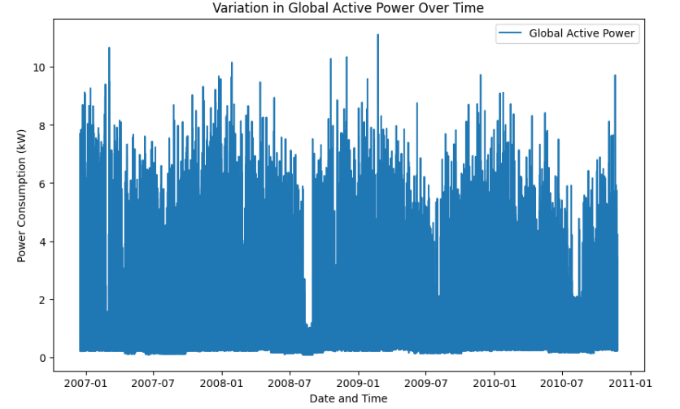
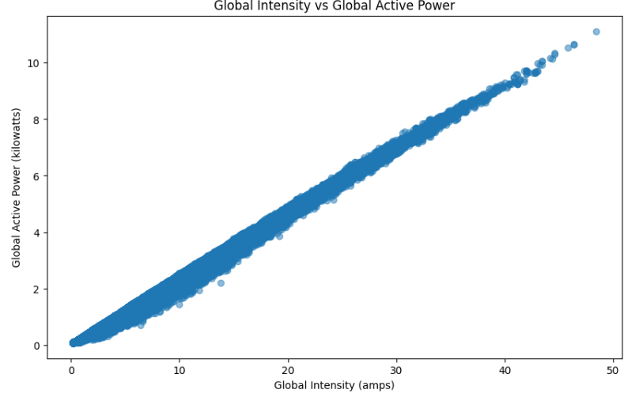
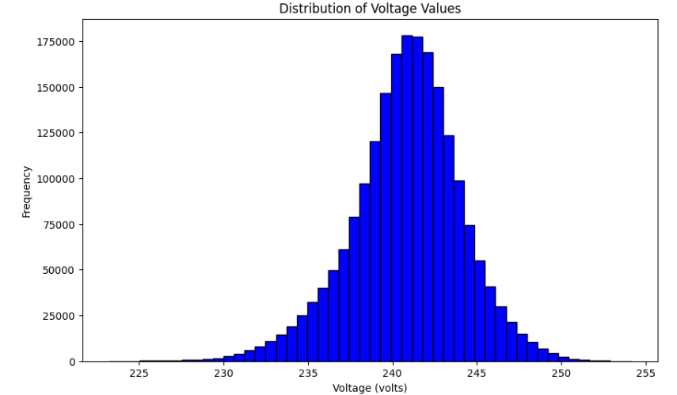
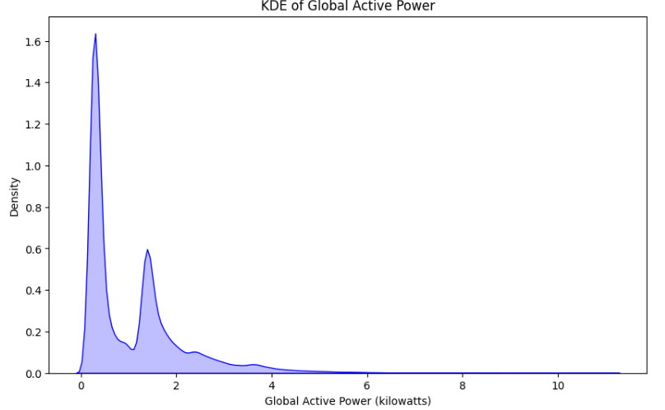
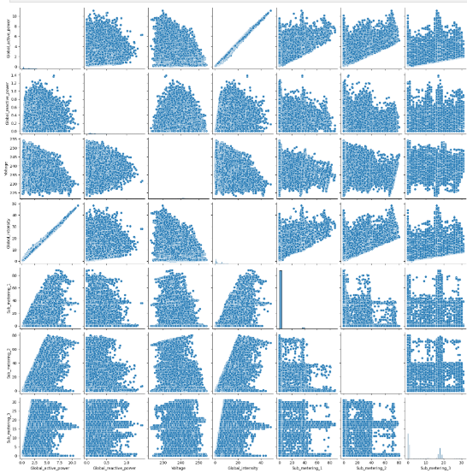
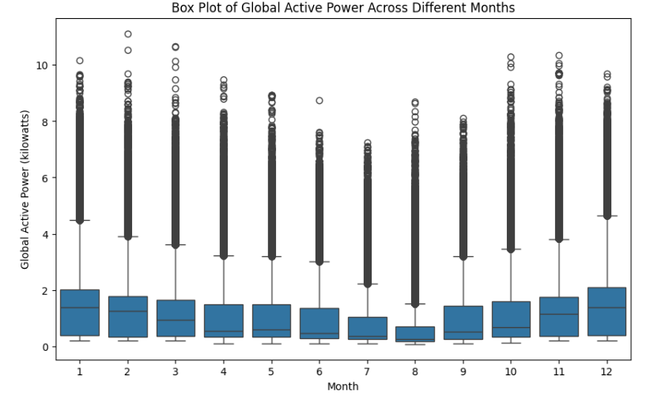
Plots:

Slide 19
Graphical Insights into Power Consumption:
Global Active Power Over Time:
Graph: Line plot of Global_active_power vs. DateTime.
Insight: Power consumption varies significantly over time, reflecting changing usage trends.
Global Intensity vs. Global Active Power:
Graph: Scatter plot of Global_intensity vs. Global_active_power.
Insight: Positive correlation—higher intensity leads to increased power consumption.
Distribution of Voltage:
Graph: Histogram of Voltage.
Insight: Voltage follows a roughly normal distribution, centered around 235–245 volts, with occasional anomalies.

Slide 20
Analysis and Recommendations:
Average Power Consumption Insights:
Holiday vs. Non-Holiday:
Graph: Bar plot of average Global_active_power.
Insight: Higher power consumption observed on holidays.
Daylight vs. Non-Daylight:
Graph: Bar plot of average Global_active_power.
Insight: Power consumption peaks during daylight hours (06:00 AM to 06:00 PM).
Conclusions and Recommendations:
Summary:
Addressed missing data and converted data types.
Engineered features like 'Holiday', 'DateTime', and 'Light' for enhanced analysis.
Recommendations:
Perform in-depth analysis of time-based trends using engineered features.
Leverage time-series models for forecasting power usage.
Handle outliers to improve prediction accuracy.

Slide 21
Milestone 3:
04
(MODEL CREATION AND COMPARISON)

Slide 22
Regression Models Overview:
Linear Regression
Linear Regression fits a straight line to the data by minimizing the error between predicted and actual values. It works well for data with strong linear relationships but struggles with overfitting. Use it for simple, interpretable models without regularization.
Lasso Regression
Lasso Regression adds a penalty to shrink coefficients, with some becoming zero, effectively performing feature selection. It reduces model complexity and is useful for identifying the most important predictors. However, it may sacrifice some accuracy compared to Ridge or Linear Regression.
Ridge Regression
Ridge Regression penalizes the square of coefficients, shrinking them toward zero but retaining all features. It prevents overfitting and is effective for datasets with multicollinearity. Use it for a balance between accuracy and complexity when all features are relevant.

Slide 23
Training and Testing:
The data is split into training (80%) and testing (20%) sets to evaluate model performance. The models (Linear, Lasso, and Ridge Regression) are trained on the training set and then tested on the unseen testing set to check generalization ability. Metrics like Mean Squared Error (MSE) are used for evaluation.
Who performs better:
Ridge Regression usually performs better in complex datasets with many correlated features because it regularizes without eliminating any variables.
Lasso Regression works well if feature selection is needed, but can sometimes lose accuracy by removing too many features.
Linear Regression is simpler but may overfit with noisy or complex data, often outperformed by Ridge and Lasso.

Slide 24
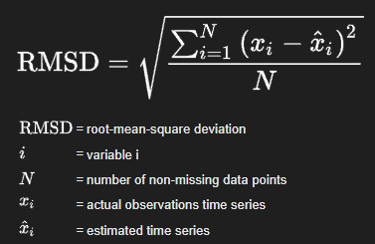

Performance Metrics:
Root Mean Squared Error (RMSE)
Definition: Measures the average magnitude of the prediction error. It gives an idea of how much error is in the model’s predictions. The lower the RMSE, the better the model.
Use Case: Used to evaluate the accuracy of regression models by measuring the difference between predicted and actual values.
R² Score
Definition: Measures how well the model explains the variance in the data. A score of 1 indicates perfect fit, while 0 indicates no explanatory power.
Use Case: Used to determine the goodness of fit for regression models.

Slide 25
Milestone 4:
05
(TIME SERIES FORECASTING WITH ARIMA
AND PROPHET MODELS)

Slide 26
Introduction to Time Series Forecasting:
Time series forecasting is used to predict future values based on past observations.
Common applications: sales predictions, stock prices, energy consumption.
In this presentation, we will forecast energy consumption using two popular models: ARIMA and Prophet.

Slide 27
ARIMA Model:
(AutoRegressive Integrated Moving Average)
ARIMA is a widely used statistical model for time series forecasting.
It combines:
AR (Auto-Regressive): The relationship between an observation and a number of lagged observations.
I (Integrated): Differencing the series to make it stationary.
MA (Moving Average): The relationship between an observation and a residual error from a moving average model.
ARIMA is used when data shows trends but not seasonal patterns.
ARIMA is used in finance, retail, healthcare, weather forecasting, transportation, energy, agriculture, telecommunications, and manufacturing for predicting trends, sales, stock prices, demand, traffic, and resource management based on historical data.

Slide 28
Steps to Implement ARIMA:
1.Data Preprocessing:
Load dataset, clean data, and handle missing values.
2.Splitting Data:
Split data into training and testing sets.
3.Model Creation:
Fit ARIMA model with selected order (p, d, q).
4.Model Evaluation:
Calculate performance metrics like RMSE to assess prediction accuracy.

Slide 29
Prophet Model:
Prophet is a forecasting tool designed to handle time series with daily observations that display patterns on different time scales.
Advantages:
Handles missing data well.
Can model holidays and seasonality.
Does not require stationarity of the data.
The Prophet model is used in forecasting demand, sales, website traffic, energy consumption, financial trends, and inventory management, as well as predicting seasonal patterns in various industries like retail and logistics.

Slide 30
Steps to Implement Prophet:
Data Preprocessing:
Convert the dataset into the format that Prophet requires.
Model Creation:
Fit Prophet model on training data.
Forecasting:
Predict future data points.
Model Evaluation:
Evaluate the forecast accuracy using RMSE or other metrics.

Slide 31
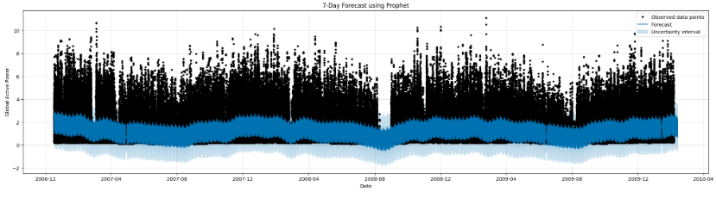
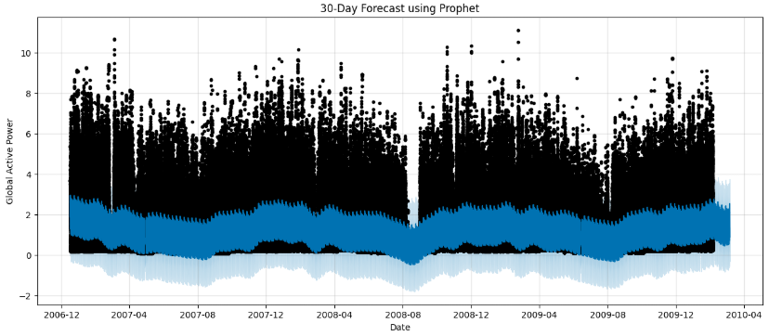
Plots from Prophet Model:

Slide 32
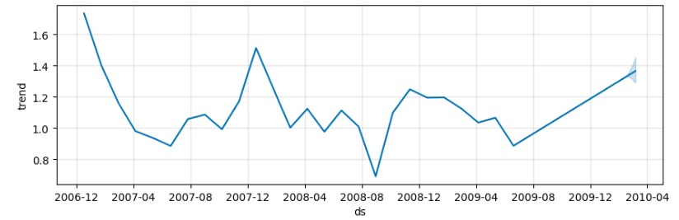
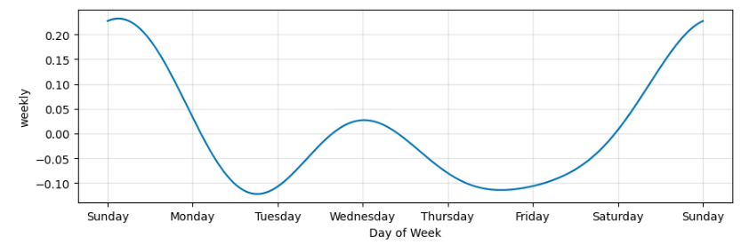
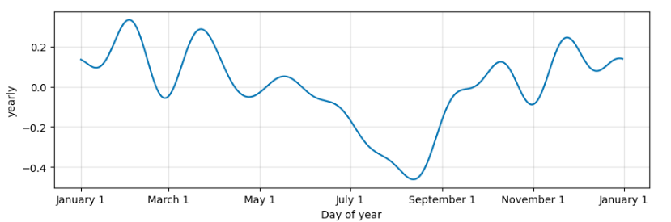
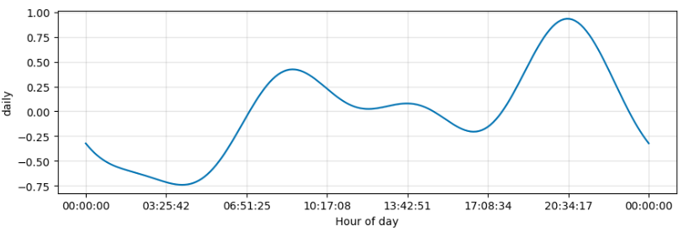
Component Analysis from Prophet Model:

Slide 33
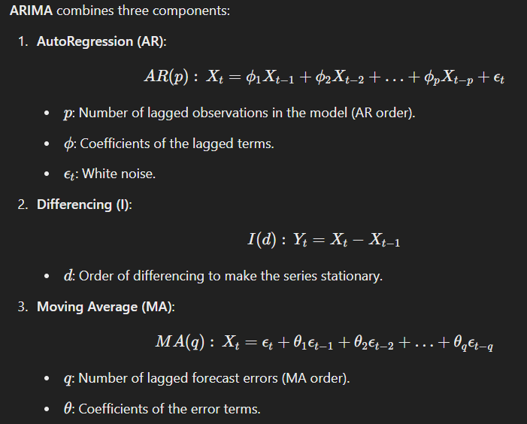
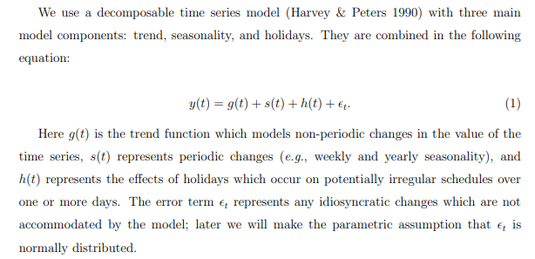
Mathematical Skeleton of the Models:
Prophet Model:
For More Info:
https://peerj.com/preprints/3190.pdf#pdfjs.action=download
https://people.duke.edu/~rnau/Mathematical_structure_of_ARIMA_models--Robert_Nau.pdf

Slide 34
Model Evaluation:
06

Slide 35


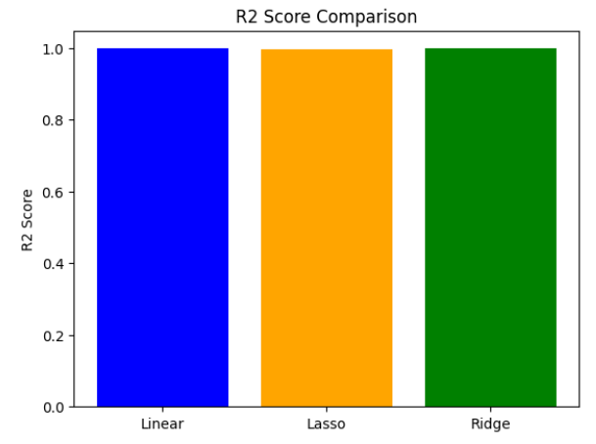
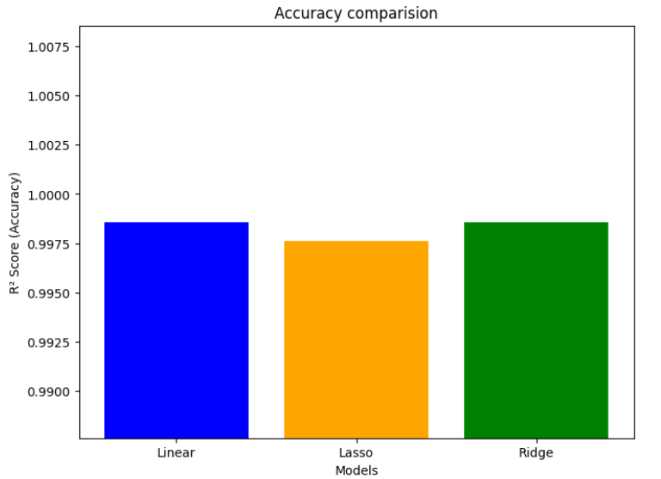
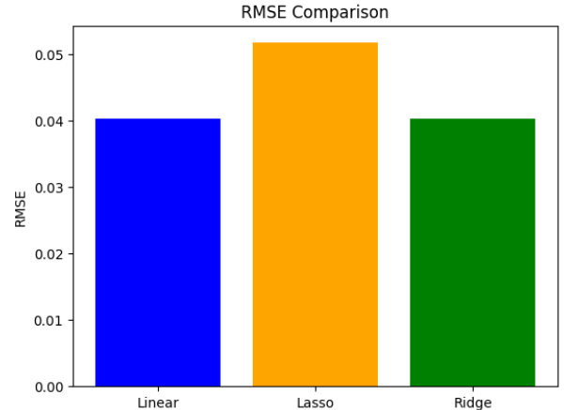
Regression Models:
Outputs:

Slide 36
Insights (Regression Models):
Linear and Ridge Regression perform equally well with high R² and low RMSE.
Lasso Regression sacrifices some accuracy for simplicity by shrinking some coefficients to zero.
RMSE Comparison: This shows that Lasso has the highest RMSE, indicating a slightly higher prediction error.
R² Score Comparison: Linear and Ridge Regression have nearly identical R² scores, indicating they explain the variance in the data similarly.
Summary:
Linear and Ridge are the most effective models for this dataset, with similar performance.
Lasso provides a more simplified model by shrinking some coefficients but sacrifices a slight bit of accuracy in doing so.

Slide 37
Results and Comparison (ARIMA and Prophet):
The ARIMA model (Order: 5,1,0) was evaluated using RMSE to predict energy consumption, revealing key patterns. The Prophet model, designed for seasonal time series, was compared to ARIMA, highlighting seasonal trends and holidays. Both models' forecast accuracy, including RMSE, was assessed through visual plots of forecasted vs. actual data.
ARIMA:
Best for stationary data.
Requires careful parameter selection (p, d, q).
Does not handle holidays or special events well.
Prophet:
Handles holidays and seasonal trends effectively.
Less sensitive to parameter tuning.
Works well with missing data.

Slide 38
Streamlit App
This script is a Streamlit-based web application designed to predict energy consumption using pre-trained
machine learning models. The application offers an interactive interface where users can inputfeatures like
voltage, global intensity, sub-metering values, and date-time throughsliders and pickers. It uses these inputs
to create a DataFrame that aligns with the models' expectedfeatures. The predictions are made using Linear
and Ridge Regression models, loaded viajoblib, and displayed dynamically with st.metric. The app also
incorporates custom styling, allowing users to select background colors and enjoy a visually appealing layout
with styled headers and input sections.

Slide 39
The application handles errors gracefully, ensuring a smooth user experience even if resources fail to load or predictions encounter issues. A disclaimer emphasizes the tool's purpose as an exploratory tool rather than one for critical energy management. By integrating robust functionality with a user-friendly interface, this script is an excellent example of how data science models can be deployed as web applications for real-world usability.

Slide 40
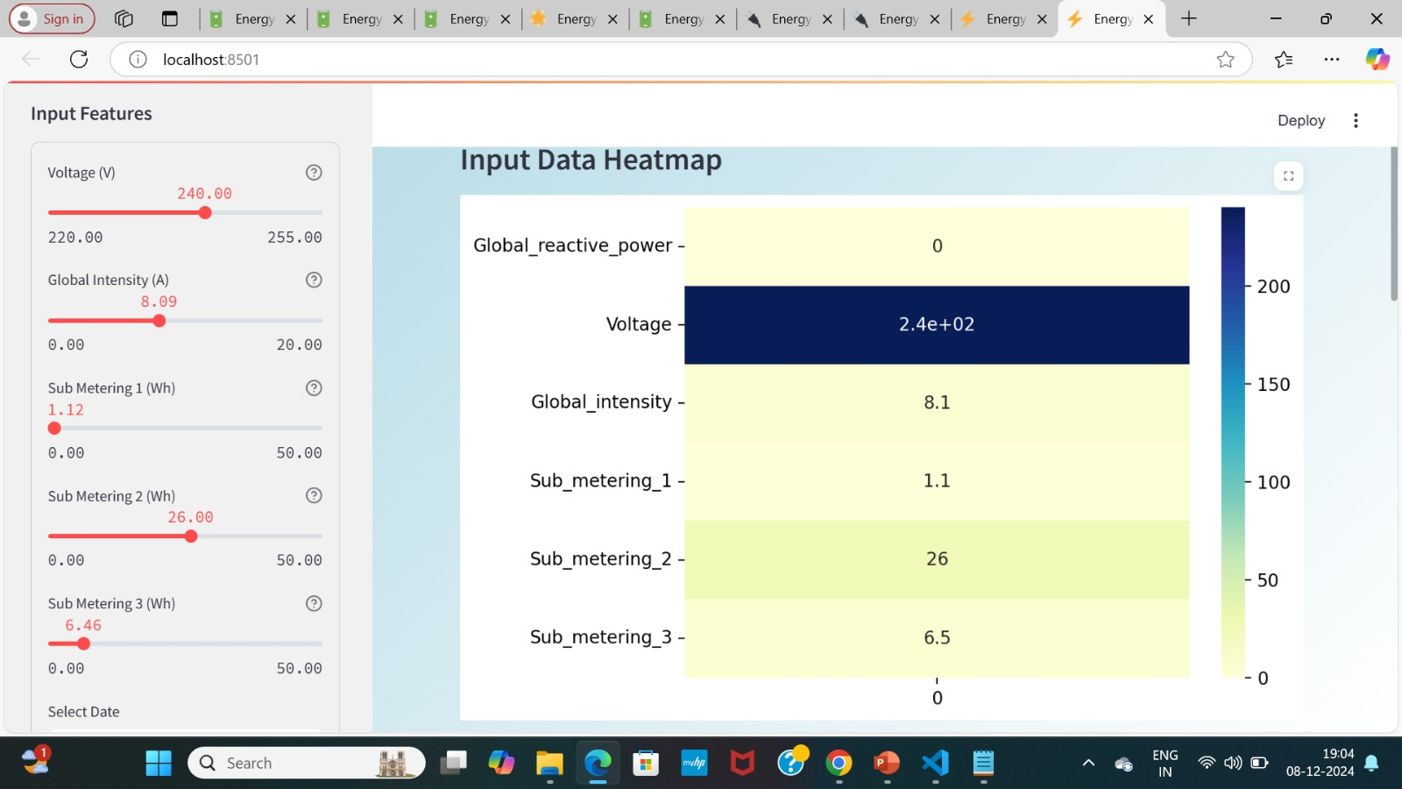
OUTPUT

Slide 41
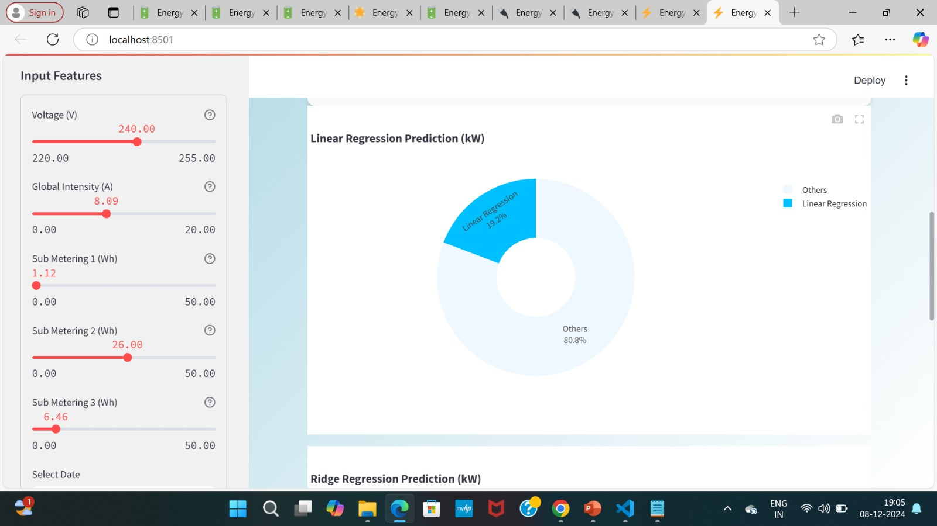

Slide 42
Conclusion:
07
GITHUB: https://github.com/kavya22115/Energy-Consumption-Predction

Slide 43
In this analysis, we have successfully cleaned and visualized energy consumption data to uncover key insights about usage patterns. By exploring hourly, daily, and seasonal trends, we identified significant consumption peaks, particularly in the evening hours, and highlighted the influence of factors like sunlight and holidays. Through robust model building, including Linear, Lasso, and Ridge regression, we evaluated the accuracy of predictions using metrics like RMSE and R², with Ridge regression offering a stable performance under multicollinearity.
forecasting techniques like ARIMA and Prophet, which allowed us to predict future energy consumption trends across weekly, monthly, and yearly intervals, enhancing our understanding of long-term energy demand. These insights can guide better energy management, helping utilities optimize grid operations and improve demand-side management strategies

Slide 44
In this project, we progressed through four key milestones. In Milestone 1, we conducted basic exploration, gaining insights into the dataset. Milestone 2 focused on visualizing parameters and performing feature engineering to prepare the data for modeling. In Milestone 3, we implemented regression models to predict energy consumption. Finally, in Milestone 4, we explored time series forecasting using ARIMA and Prophet models, analyzing their accuracy in predicting future energy usage. Each milestone built upon the previous one, enhancing our understanding and prediction capabilities, ultimately leading to a comprehensive analysis of energy consumption trends. Through these efforts, we have achieved an efficient and reliable analysis and prediction of energy consumption patterns.

Slide 45
Thank You

